Slide 1
L4/5 GROUP 11
Thomas wenman
Jordan marks
Mark key
Mohammad miah

Slide 2
LOGLINE
After being thrown back in time after reading a book, Lily must uncover the research notes of Da Vinci’ time machine to get back into the present day.
Target audience: 13/18 year olds.

Slide 3
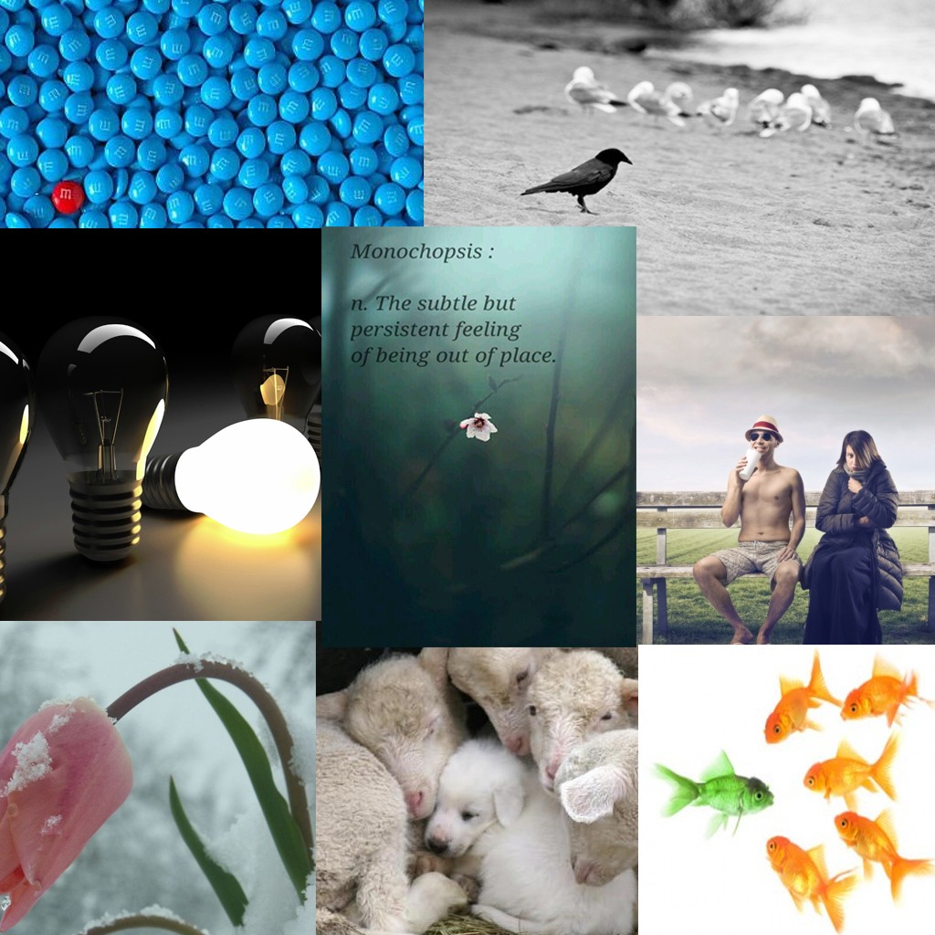
Monachopsis
“The subtle but persistent feeling of being out of place.”

Slide 4
Vellichor

Slide 5
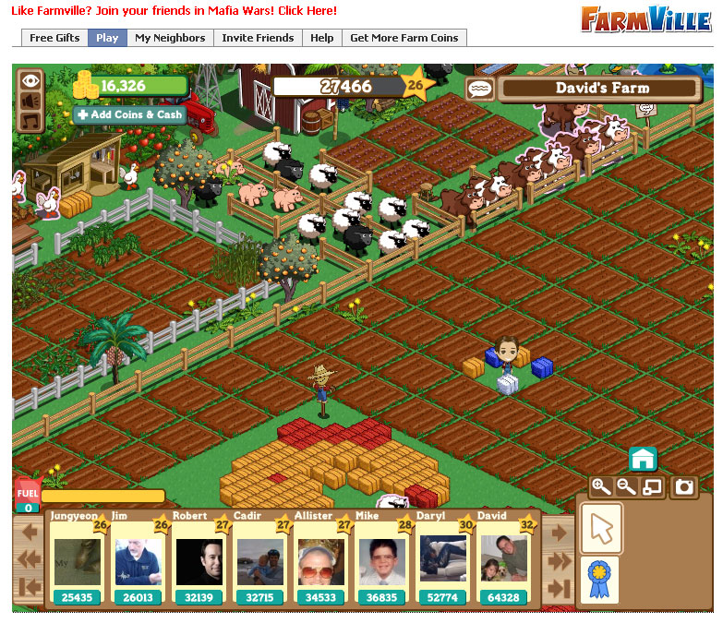
UI
RTS Camera
Inventory space
Timer (when doing puzzles)
Hint box

Slide 6
Core mechanics, dynamics and aesthetics
Mechanics | Dynamics | Aesthetics
Seeking | Progression dynamic | Satisfaction of solving tough puzzles
Rewards | Scarcity (Upgrades become a necessity later on) | Discovery
Levels | Collection | Challenge
Countdown
For the player experience, we’re aiming for Hard fun.
I.e. Meaningful challenges, strategies and puzzles.

Slide 7
Questions?

